Slide 1


Team Name: StarX
Challenge: Near-Space Near You!
Team Members: Sasan Radan, Ritu Malhorta, Amz Hundal

Slide 2

What does the world have to gain? Where is the opportunity?
The field of space and space travel is never ending with new discoveries being made everyday. The opportunity of exploration lies within our own hands, with the possibilities being endless.

Slide 3

What problem does your project solve?
This Project provides a lesson-plan and bill of materials (BOM) on how to build a low-cost high-altitude balloon capable of reaching near-space, 20 - 100 kilometres above sea level
Our project provides a much more affordable alternative and approach for those who are passionate about exploring the field of space travel.

Slide 4

Understanding of the challenge and your approach to solving it
When approaching the challenge we started of by carrying out research and trying to better understand the concept of High altitude of balloons.
Once we had gained a better understating it was time to tackle the challenge.

Slide 5

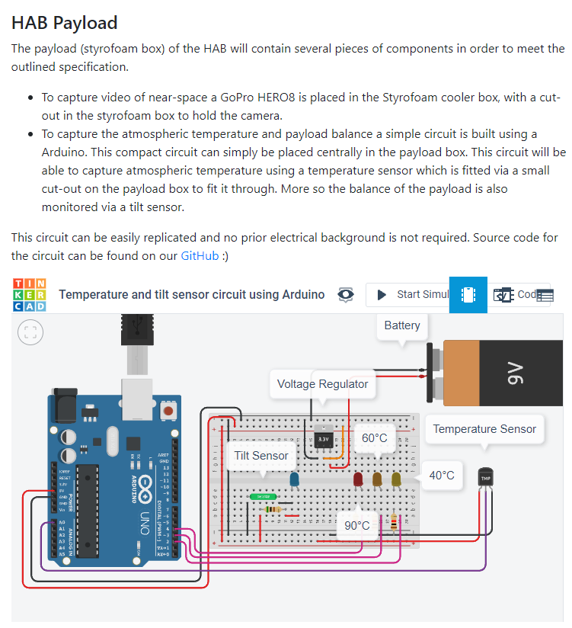
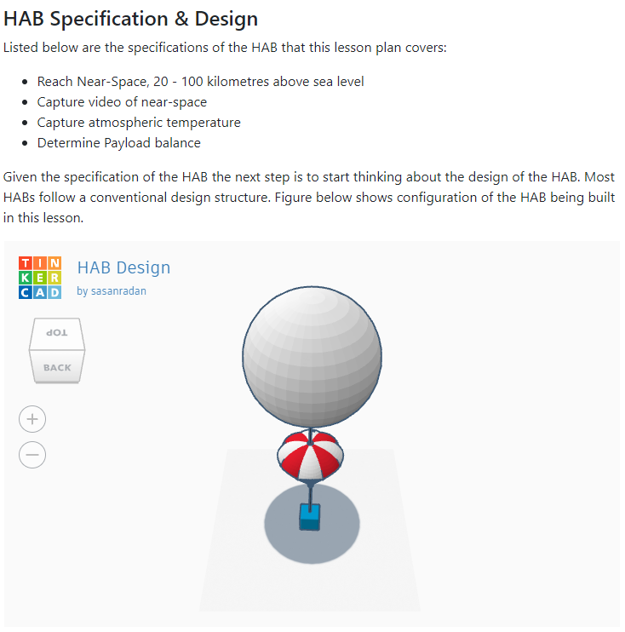
Project Snapshot
Bill of materials (BOM)
Interactive 3D Modelling
Interactive Circuit simulation
The knowledge gained from Nasa sources such Scientific Balloons as resulted in opting for Conventional ballooning approach which uses direct line-of-sight electronics for command and data, with flight durations ranging from a few hours to days. This determined the BOM and overall build.

Slide 6

Future Development
For future development it would be intriguing to look into exploring Long Duration Ballooning or Ultra Long Duration Ballooning (ULDB) and possibly introducing an aspect of AI where artificial intelligence is used to steer the HAB.

Slide 7
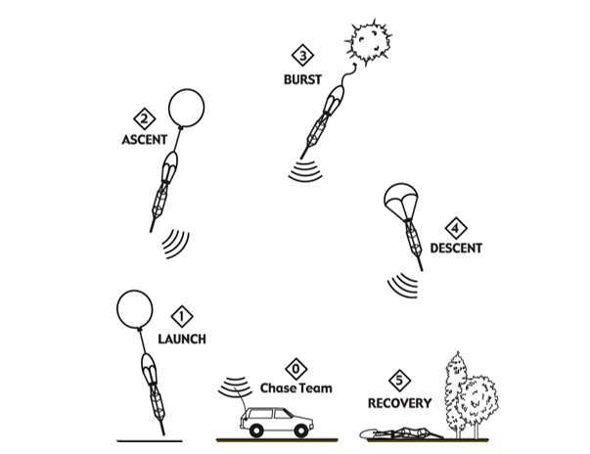
Recap
Our in depth lesson plan provides insight on; background of HAB, Bill of materials (BOM), laws and regulations, how HAB works, designing and building a HAB and should be considered for anyone who is looking into developing their own HAB

